Slide 1
Doc. 3.4(3)/1 (EC-76)
Draft Resolution 3.4(3)/1 (EC-76)
Reconfirmation of WMO RTCs

Slide 2
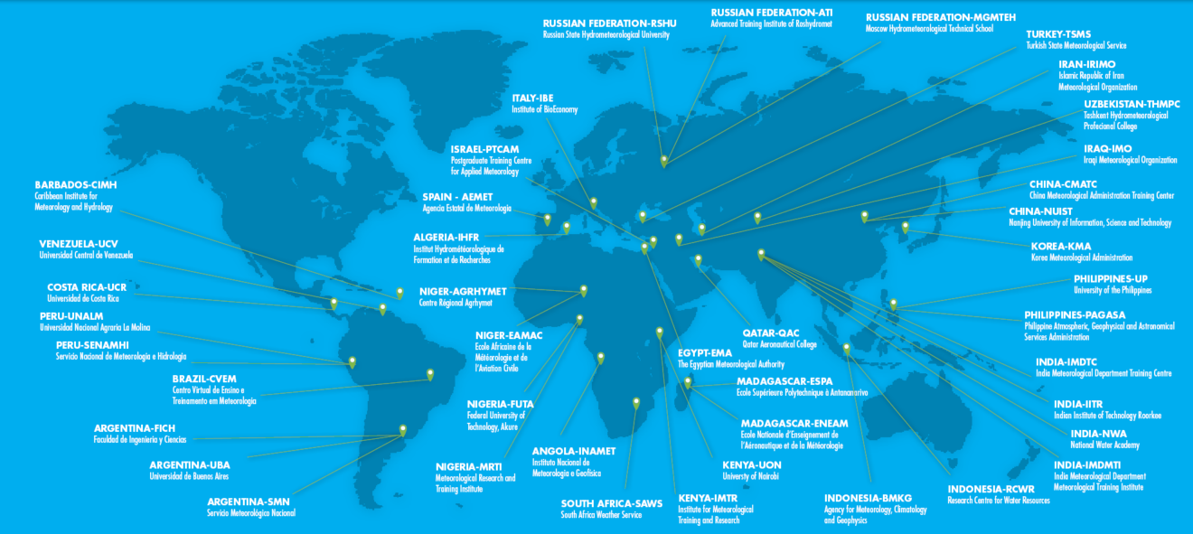
WMO Regional Training Centres
(RTCs)
28 Members host 43 RTC Components
EC-48 requested to review each RTC every 8 years (two financial periods)
RTC criteria approved by EC-66 and updated by EC-68
Capacity Development Panel (CDP) reviews 4-5 RTCs each year against criteria
Reviews of RTCs in India, Italy, and Russian Federation were completed after EC-75
Reviews of RTCs in Costa Rica, Indonesia, and Türkiye are being completed

Slide 3
Draft Resolution 3.4(3)/1 (EC-76)
Following recommendations of TCC-2022 and PAC-2022 to consolidate relevant Resolutions and Decisions
All resolutions were scanned from EC-1 and Cg-1 to the date
Current Draft Resolution consolidates all Resolutions and Decisions regarding designation of RTCs, reconfirmation of the status RTCs, postponement of reconfirmation of the RTCs
Noting that the external review of the RTC in Italy was completed and the Draft Resolution has been updated with the WiP version
The Draft Resolution includes three decision;
Reconfirmation of RTCs in India, Italy, and Russian Federation based on the external review of RTCs and recommendation of Capacity Development Panel (CDP)
Extending the reconfirmation of the remaining RTCs until subsequent EC resolutions following the future external reviews of those RTCs by the CDP
Consolidate relevant Resolutions and Decision and update the status of RTCs as given in the Annex of the Draft Resolution
The EC-76 is invited to adopt the Draft Resolution 3.4(3)/1 (EC-76)

Slide 4
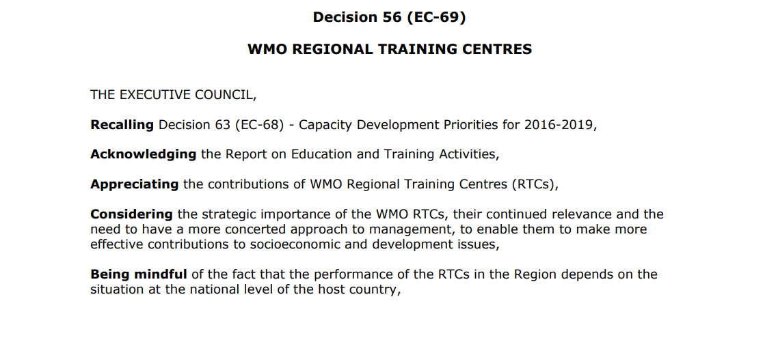
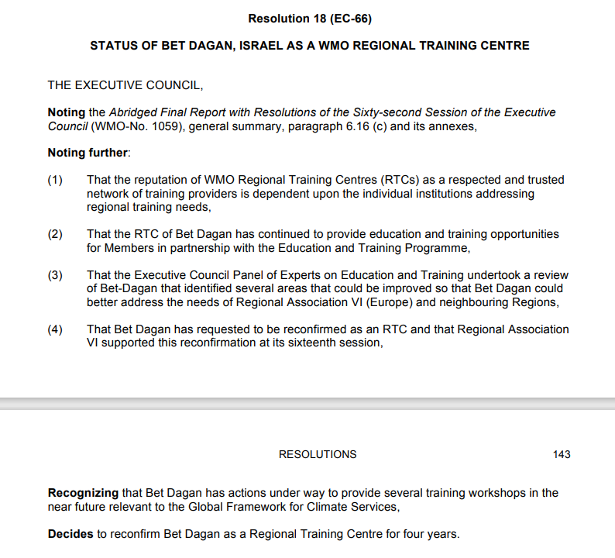
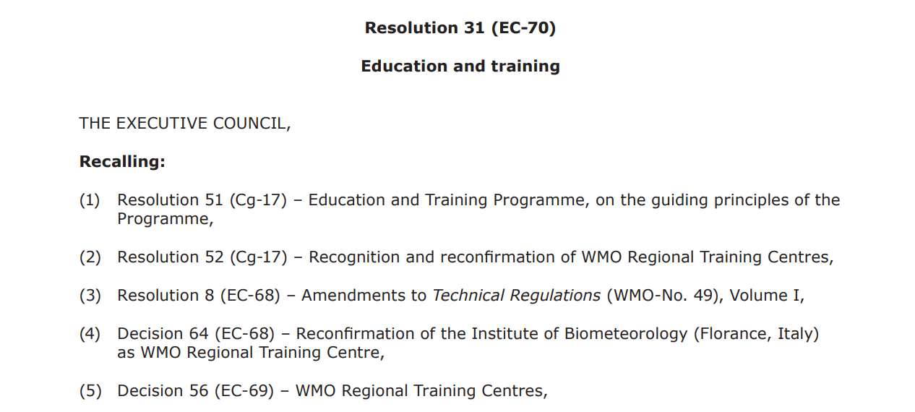
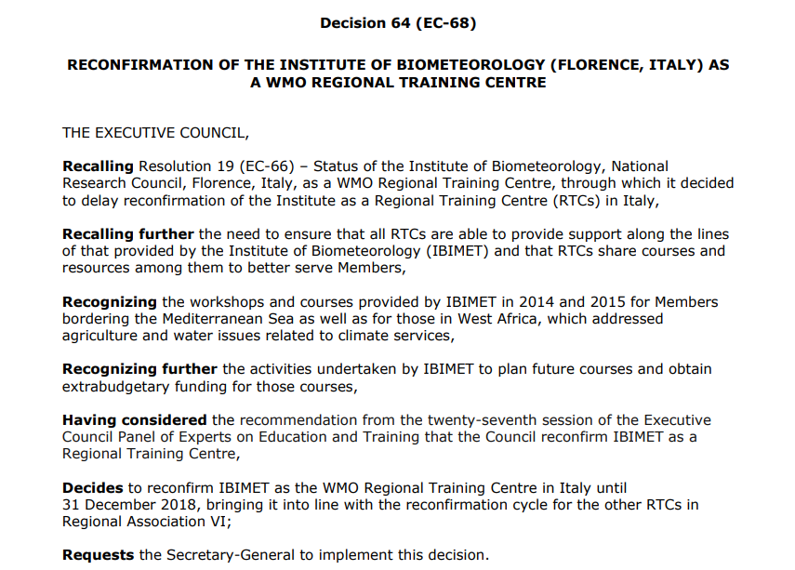
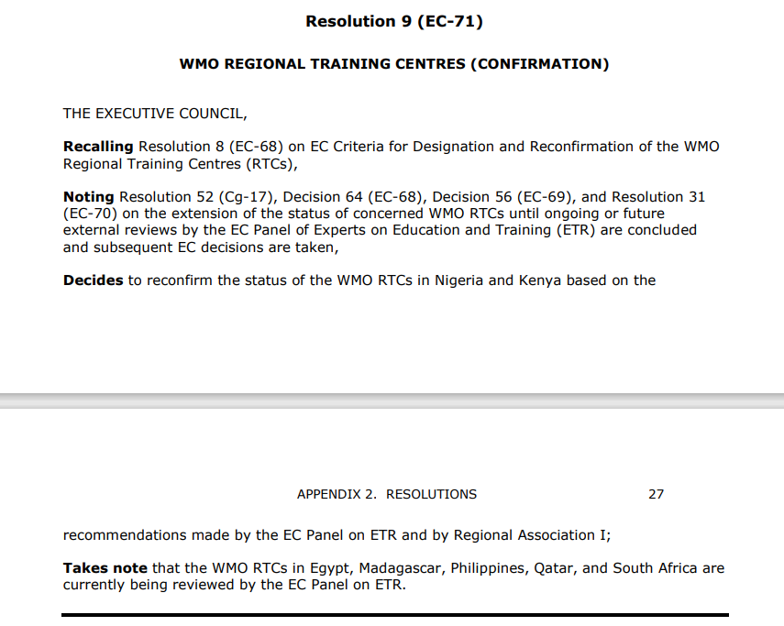
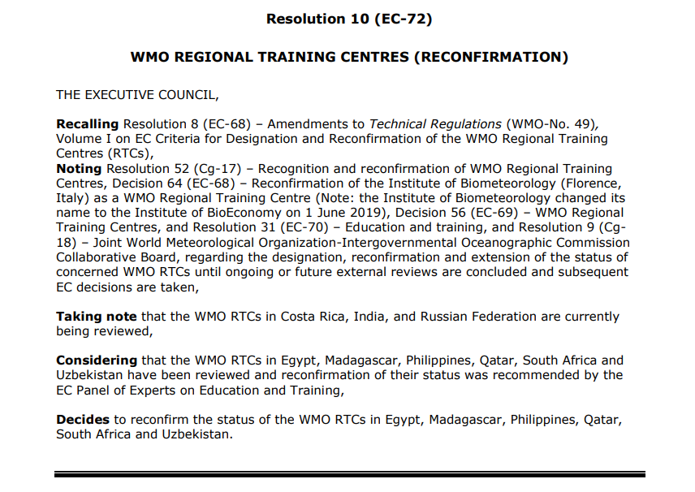
Instead of many Resolutions and Decisions on RTCs

Slide 5
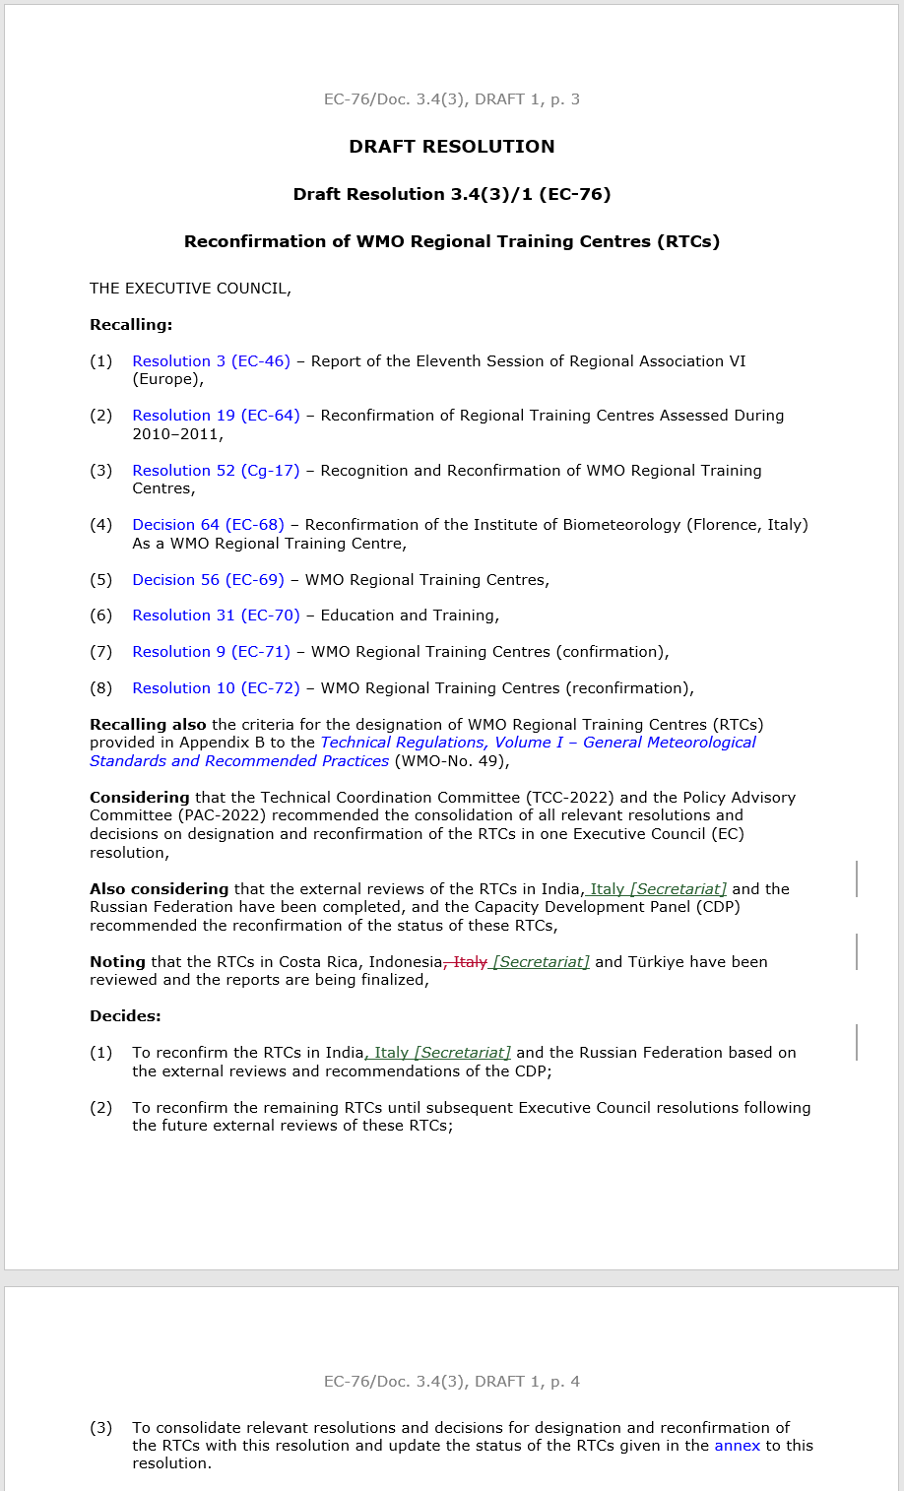
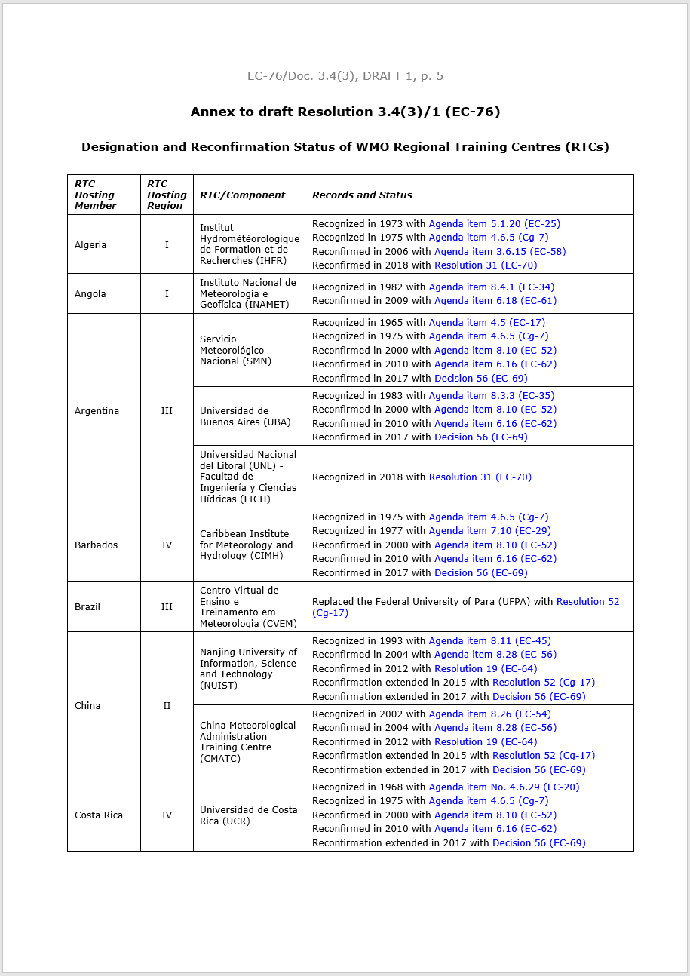
One Consolidated EC Resolution
to keep the status of all WMO RTCs up-to-date

Slide 6
Thank you

